Slide 1

Data Engineering
Team ByteBuilders
Notes:
Hello Everyone, we are byte builders

Slide 2

Team:
Course: Data Engineering
University: Portland State University
Professors: Mina Vu and Bruce Irvin
Team ByteBuilders:
Manisha Kumari kumari@pdx.edu
Manisha Katta manishak@pdx.edu
Prathamesh Chakote chakote@pdx.edu
Taariq Mansurie mansurie@pdx.edu
Notes:
We are team of 4. I’m Taariq Mansurie and we have with us Manisha Kumari, Manisha Katta, Prathamesh Chakote

Slide 3
Overview:
Build a pipeline for Trimet dataset
Automatically gather the GPS sensor data from a server daily
Parse the data into individual breadcrumb readings
Transport the data through an asynchronous event system (Google Cloud Pub/Sub)
Storing into GCP Storage
Validate the data
Transform the data as needed for analysis
Enhance the data to produce absolute timestamps
Load the data into a SQL database
Integrate bus BreadCrumb data with associated route Stop Events data.
Data visualizations
Notes:
We automated and integrated a pipeline for trimet data.This project involves building an automated pipeline to handle Trimet bus GPS sensor data. The pipeline will automatically collect daily GPS bus data from a server, parse it into breadcrumb readings, and transport it via Google Cloud Pub/Sub to GCP Storage. The data will be validated, transformed for analysis, and enhanced with absolute timestamps before being loaded into a SQL database. Additionally, bus breadcrumb data will be integrated with route stop events data for comprehensive data visualizations.

Slide 4
About Dataset:
TriMet is the regional transit organization for the metropolitan area of Portland, Oregon.
It operates a fleet of 600+ buses servicing over 80 routes and one FX line to satisfy the daily public transportation needs of residents in the Portland metro area.
TriMet monitors this system with a wireless sensor network that collects Global Positioning System (GPS) coordinates of each bus every 5 seconds yielding nearly 2M sensor readings (known as breadcrumb data) every day.
Notes:
TriMet, the regional transit organization for Portland, Oregon, operates over 600 buses on 80+ routes. To manage this extensive network, TriMet uses a wireless sensor system that captures GPS data from each bus every 5 seconds, resulting in nearly 2 million daily sensor readings. This breadcrumb data helps monitor and optimize the city's public transportation system.

Slide 5
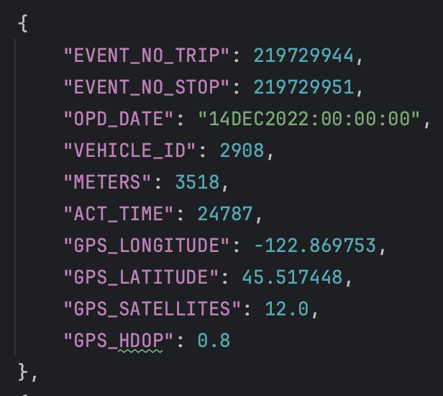

Dataset (Breadcrumbs data):
Instructor has developed a simple web server that provides access to one day’s worth of TriMet GPS 5-second-interval “breadcrumb” data for the buses in the TriMet system.

Slide 6
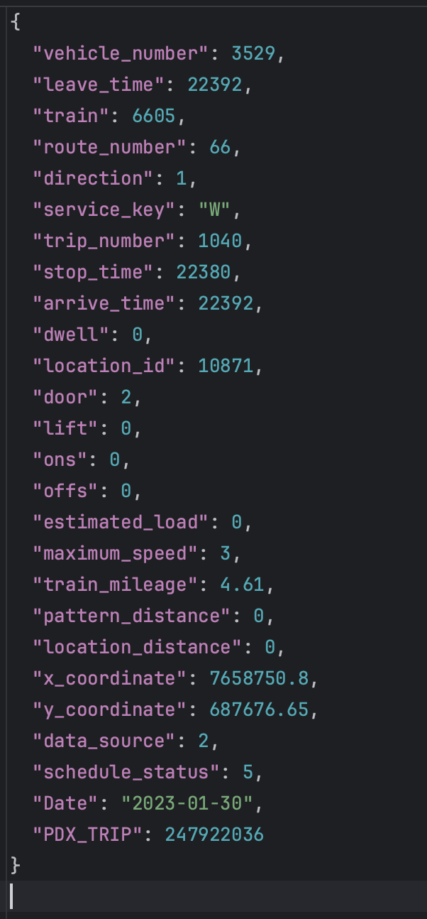
Dataset (Stopevent data):
As with the previous data source, this data set gives all TriMet vehicle stop events for a single day of operation

Slide 7
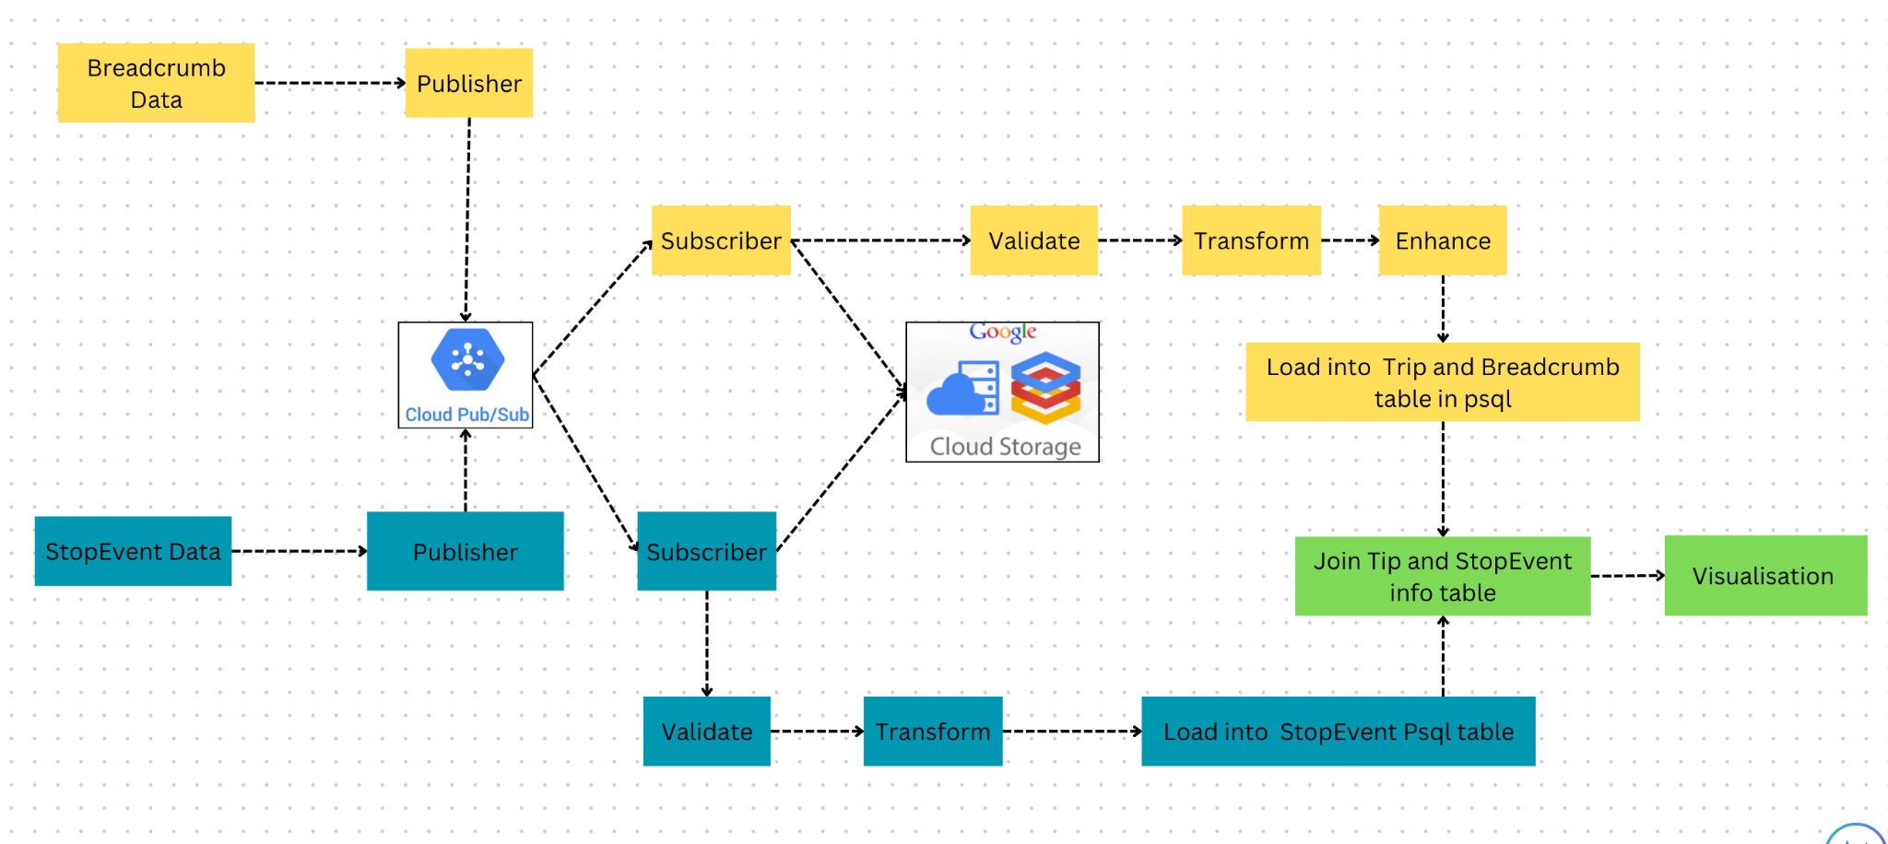
Design:

Slide 8
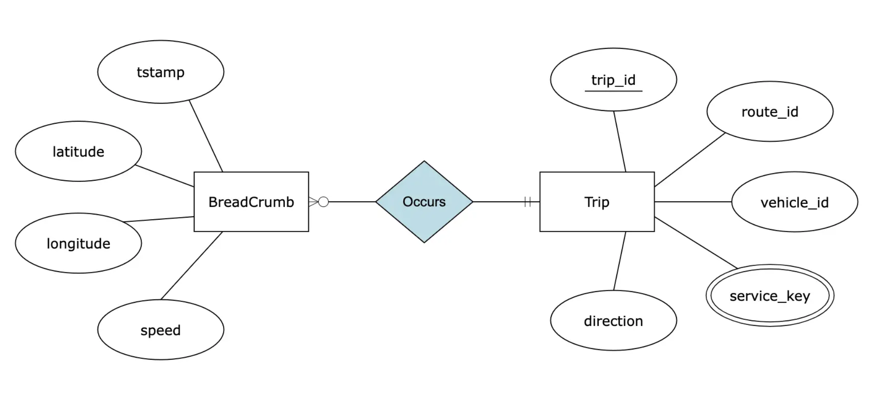
Database Table Structure:

Slide 9

Architecture (VM Config.):
Machine type: e2-medium
Architecture: x86/64
IP stack type: IPv4
Architecture: x86/64
Name: instance-20240416-045916-a
Instance Id: 6659132498153552651
Cloud API access scopes: Allow full access to all Cloud APIs
Notes:
VM as Virtual Machine
2 Different VM used which are located in different Regions
For this project, we utilized a Google Cloud VM instance with the following specifications to ensure optimal performance and reliability:
Machine Type: e2-medium
Architecture: x86/64
IP Stack Type: IPv4
Cloud API Access Scopes: Full access to all Cloud APIs, enabling seamless integration and comprehensive data handling capabilities.
These specifications provided a robust foundation for our data pipeline, facilitating efficient data processing and storage operations.

Slide 10
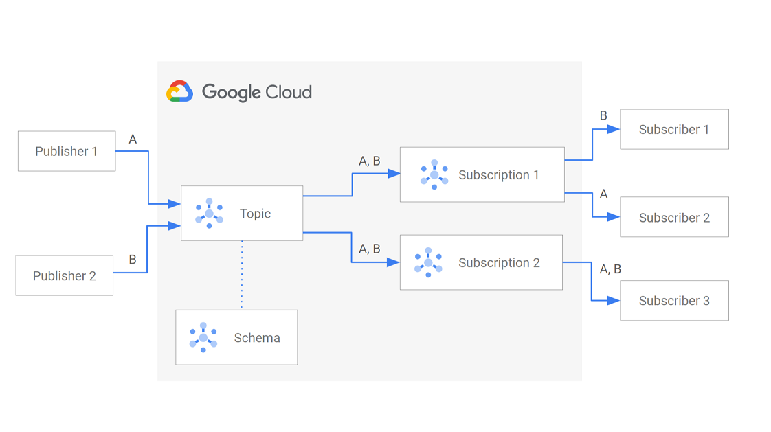
Architecture (PUB-SUB):
A messaging service for real-time and reliable messaging between applications.
Components:
Publisher: Sends messages to a topic.
Subscriber: Receives messages from a subscription to a topic.
Topic: Named resource to which messages are sent.
Subscription: Named resource representing the stream of messages from a single, specific topic, to be delivered to the subscribing application.
Notes:
Google Cloud Pub/Sub is a powerful messaging service designed for real-time and reliable communication between applications. Here’s how it works:
Publisher: Sends messages to a topic, ensuring data is distributed quickly and efficiently.
Subscriber: Receives messages from a subscription, allowing for immediate processing.
Topic: The named resource where messages are sent, acting as the central hub.
Subscription: Represents the stream of messages from a specific topic, delivering them directly to the subscribing application for seamless integration.
By leveraging these components, we achieved a highly responsive and reliable data pipeline, capable of handling real-time data flow with ease.

Slide 11

Architecture (Publisher):
Initialization: Configure logging for monitoring; Set up Google Cloud Pub/Sub client; Define list of vehicle IDs to process.
Function Definitions:
get_response_details(vehicle_id): Fetch breadcrumbs data from the bus data API for a specific vehicle ID.
publish_to_pubsub(vehicle_id, event): Publish fetched data to Google Cloud Pub/Sub.
Main Execution
Create and start threads to process vehicle IDs concurrently; Join threads to ensure all processing is completed.
Notes:
Let’s dive into the core components of our system that ensure smooth and efficient data processing:
Initialization:
Logging Configuration: Set up comprehensive logging for real-time monitoring and troubleshooting.
Pub/Sub Client Setup: Establish a connection to Google Cloud Pub/Sub for seamless message handling.
Vehicle IDs: Define a list of vehicle IDs to focus our data processing efforts.
Function Definitions:
get_response_details(vehicle_id): Fetch detailed breadcrumb data from the bus data API for each vehicle ID.
publish_to_pubsub(vehicle_id, event): Efficiently publish the fetched data to Google Cloud Pub/Sub for downstream processing.
Main Execution:
Threading: Create and initiate threads to process vehicle IDs concurrently, maximizing our processing speed.
Synchronization: Use thread joining to ensure that all vehicle IDs are processed completely before moving forward.
This structured approach enabled us to handle high volumes of real-time data efficiently, ensuring accuracy and timeliness in our data pipeline.
4o

Slide 12

Architecture (Subscriber):
validate_message(message, validators):
Returns True if all validations pass, False otherwise
callback(message): Decode base64 data if necessary, Deserialize JSON data, Append breadcrumb to gcs_messages, Validate breadcrumb using, validate_message, Acknowledge message if validation passes, otherwise, negative acknowledgment
Post-Processing: If subscription times out:Save gcs_messages to GCS, Process validated_messages with, process_validated_messages, Validate speed using validate_speed_, Copy trip data to PostgreSQL using copy_trip_data, Filter and copy breadcrumbs to PostgreSQL using filter_and_copy_to_postgres
Close database connection

Slide 13
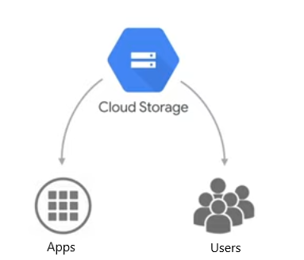
GCP Cloud storage:
A scalable and secure object storage service provided by Google Cloud.
Used for storing and accessing large amounts of unstructured data, such as text, binary data, images, and more.
Collected messages during processing.
Converted messages to CSV format.
Compressed the csv file
Uploaded the CSV file to GCS for storage and future access.

Slide 14
Data Validations:
Validate the data based on data constraints.
To validate the data added 10 different assertion based parameters of breadcrumb data.
Added 5 more validations for StopEvent data
Sample assertion: if location (latitude and longitude) is not in Portland area then discard.
Based of validations, if data is not passed required validation then simply discard the breadcrumb data.
Help to minimise the noise in data also removed unwanted outliers.

Slide 15
Transformation and Enhancement :
Transformation | Enhancement
1. Based on the validation failures data were transformed to match the requirements | Based on the requirement of data were enhanced it to match the requirements
2. Some important transformations: A. Removing null values and duplicates to match table schema B. Changing of time to psql Timestamp data type | 2. The breadcrumb data went through some major enhancement one of which was: A. Speed calculation

Slide 16
Integration:
We have 3 psql tables namely: a. Breadcrumb b. Trip c. event_info
Trip table required three informations from event_info which were route_id, service_key, and direction.
Used update command to update trip by joining it with table event_info based on trip_id and vehicle_id

Slide 17
Data Analysis:
Breadcrumbs data
A. Total data received: 954.7210 MB
B. Number of records stored: 14,079,025
C. weekday Average amount of data following through pipeline: 320529 records which is 21.7 MB
D. Average number of data following through pipeline on weekend: 196289 records 17.4 MB
Stop events data A. Total stop events’ data received: 37.30 MB
B. Number of stop events records: 550,107
C. Weekday Average amount of data following through pipeline: 39569 records which is 2.68 MB D. Weekend average amount of data following through pipeline: 23323 records which is 1.58 MB

Slide 18
Visualization 1:
Description: This visualization shows us all the Trimet points around Goose Hollow which is our residency, on Monday mornings from 9 to 5pm. We were curious about the amount of TriMet points around our home and its distribution so we thought of querying it and visualizing it.
Query =
SELECT DISTINCT b.longitude, b.latitude, b.speed FROM Trip t
JOIN BreadCrumb b ON t.trip_id = b.trip_id
WHERE (b.latitude BETWEEN 45.51552896736652 AND 45.51829824128865)
AND (b.longitude BETWEEN -122.69432826013855 AND -122.6893552049442)
And date(b.tstamp) = date '2023-01-23'
AND b.tstamp >= '2023-01-23 09:00:00'
AND b.tstamp <= '2023-01-23 17:00:00';

Slide 19
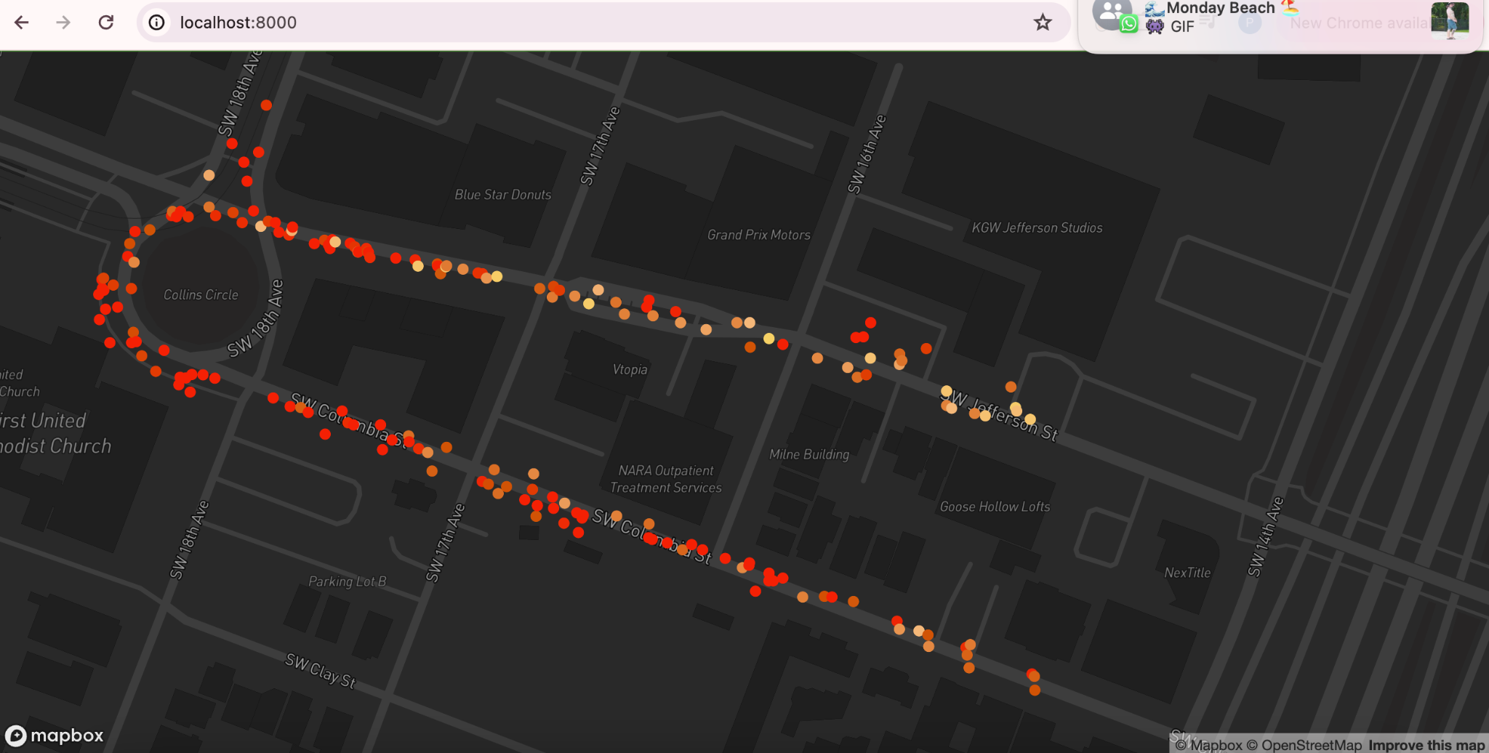

Slide 20
Visualization 2:
Description: The route traveled by trip_id 240258531 is displayed in this visualization, with emphasis on the starting and finishing locations, midway stops, and overall trajectory. It facilitates geographic coverage.
Query:
SELECT b.longitude, b.latitude, b.speed
FROM breadcrumb b
WHERE trip_id=240258531;

Slide 21
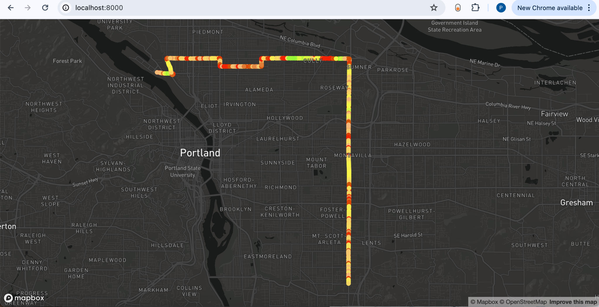

Slide 22
Challenges:
Vm crashes
Integration issues with amount of data we have
Deciding transformations for validations failure
Amount of time taken by publisher and subscriber was too long prior to parallelization using thread
Resolving error while inserting data into trip table with primary key constraint
Notes:
Added multiple i/o operations

Slide 23
Extra Credits:
Used multiple VMs to implement our pipeline
Implemented data archiving using GCP Cloud storage.

Slide 24
Conclusion:
The project provided valuable experience in handling real-world data and building a robust data pipeline. We meticulously navigated each step, from data ingestion and validation to processing and storage. This comprehensive approach allowed us to effectively manage and analyze data, ultimately drawing meaningful conclusions and insights.

Slide 25
Thank you!
Special thanks to Timet, Professor Mina, Professor Bruce, and Vysali
Notes:
Finish the presentation with a “Thank You” slide. Feel free to thank anybody who helped you, but at the very least be sure to thank TriMet for sharing their valuable real-world data for your project.

